Slide 1
Lecture 14
The Structure of the Urban Systems and the Laws of Geography
14.1 The Laws of Geography
IUS 8.1
©Luís M. A. Bettencourt 2024
Notes:
This module - and sequence- is about the properties of systems of cities (urban systems), such as the USA, or China. This is the largest scale we will consider, and was the scale at which many results emerged that were general, characterizing urban systems in the second half of the 20th century: I will refer to these regularities as the ‘Laws of geography’.

Slide 2
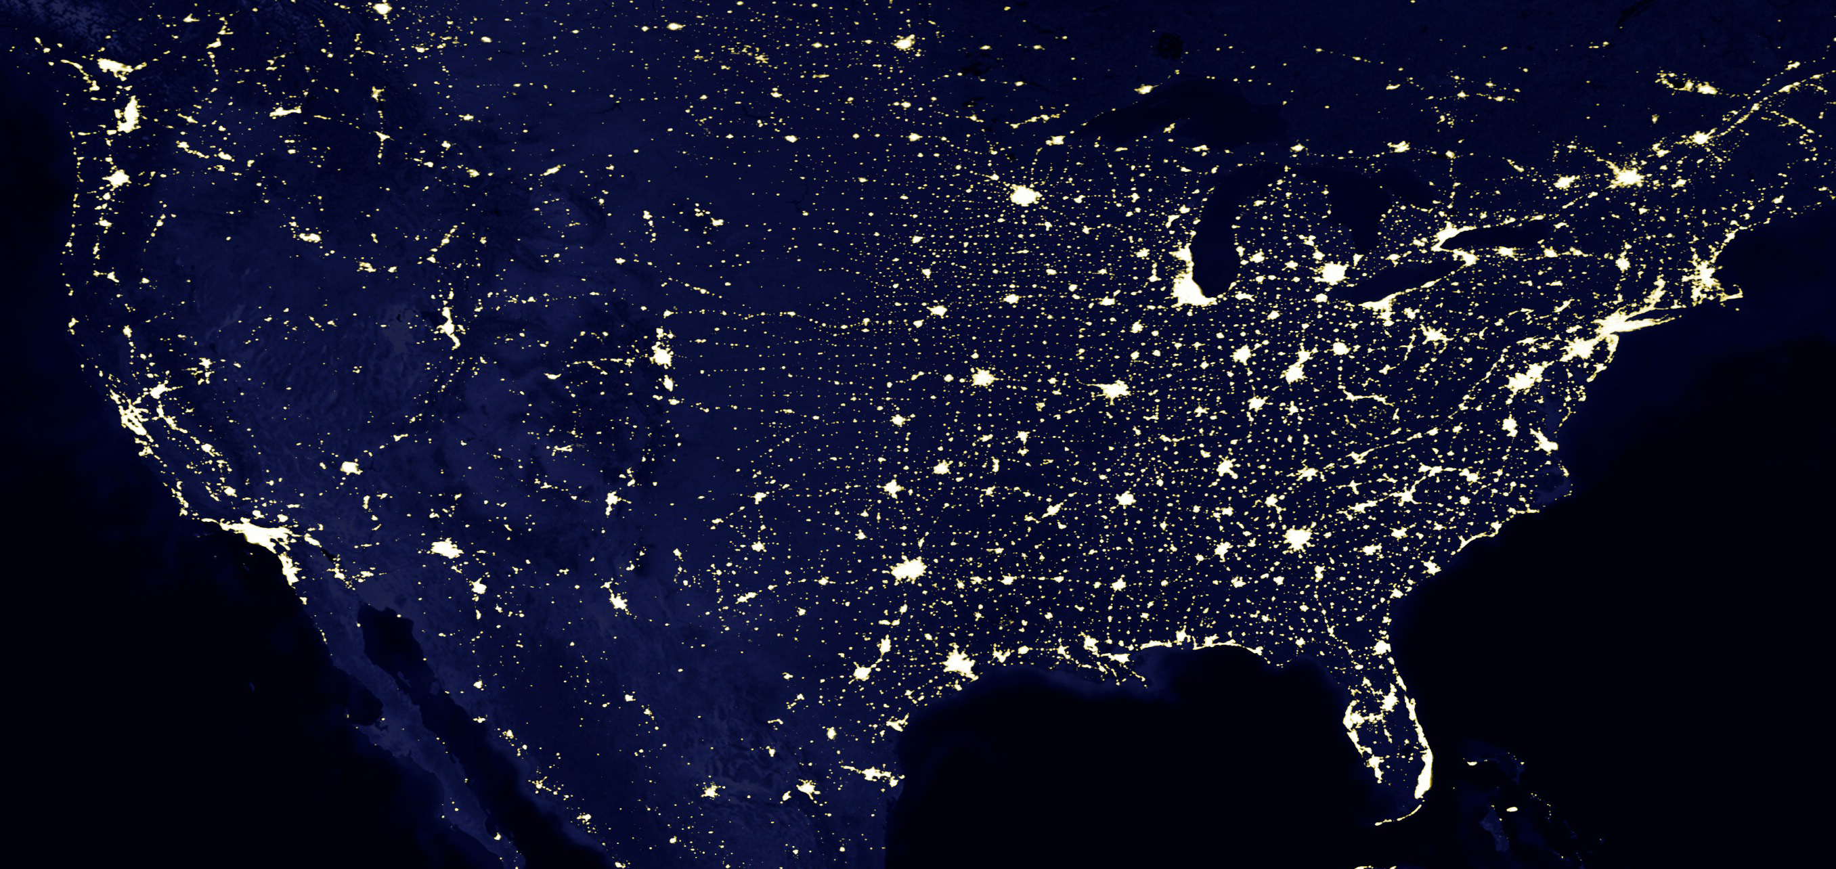
Empirical “Laws” in Urban Systems
https://blackmarble.gsfc.nasa.gov
credit: NASA
Notes:
This is an image of the Earth at night over the US. It allows us to clearly see cities as bright spots. It also gives us a rough sense that there are a few large cities and many smaller ones, of progressively smaller sizes. Also that spatially there are often larger distances between the largest cities: All these observations lead to (somewhat) predictable statistics: the laws of geography.

Slide 3
The Laws of (Urban) Geography
Central Place Theory & Urban Hierarchy
Tobler’s Two Laws
3. The Gravity Law for Flows
4. Gibrat’s Law of Proportional Growth
5. Zipf’s Law for the Size Distribution of Cities
Notes:
So here is a list of these ‘laws’. We will see that these have different meanings and may apply more or less well to data. In general, all these are quite rough, but all have a grand of truth. Our aim will be not only to discuss what they are but also to understand where they come from, and what observed deviations to their patterns mean.

Slide 4
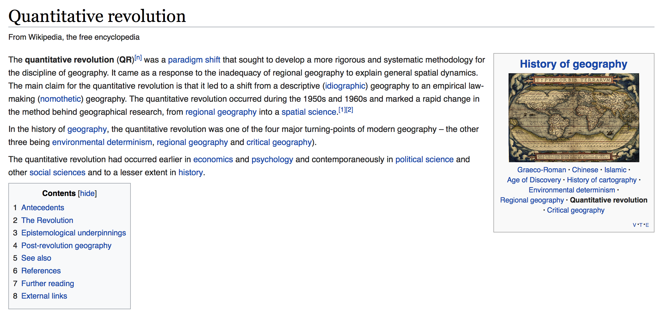
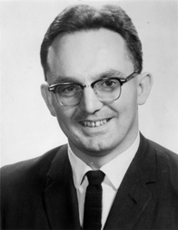

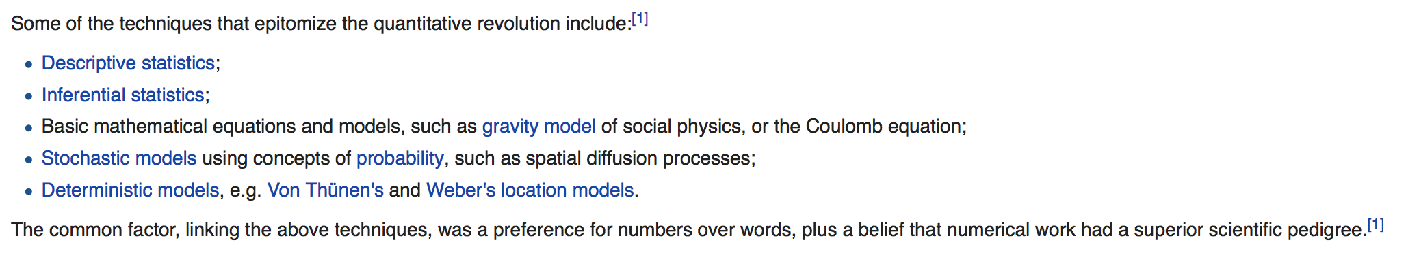
The “Quantitative Revolution” in Geography
Brian J. L. Berry
This gave you GIS and all the spatial apps on your phone
Notes:
The backdrop to this was a period in the social sciences post WW 2 that became known as the “quantitative revolution”. This lead to GIS systems, and the kinds of things that allow digital maps everywhere, starting with your phone and GPS and so on. It was driven by a growth in data and statistics that were created in part during the war effort and the space age. After the quantitative revolution, there was a “cultural turn” where geography and most other social sciences (except economics) disavowed quantitative methods, the legacy of these disagreements (which are rather hard to understand from today’s perspective) is still with us today in most university departments. It could be argued that we are now in a second quantitative revolution…

Slide 5
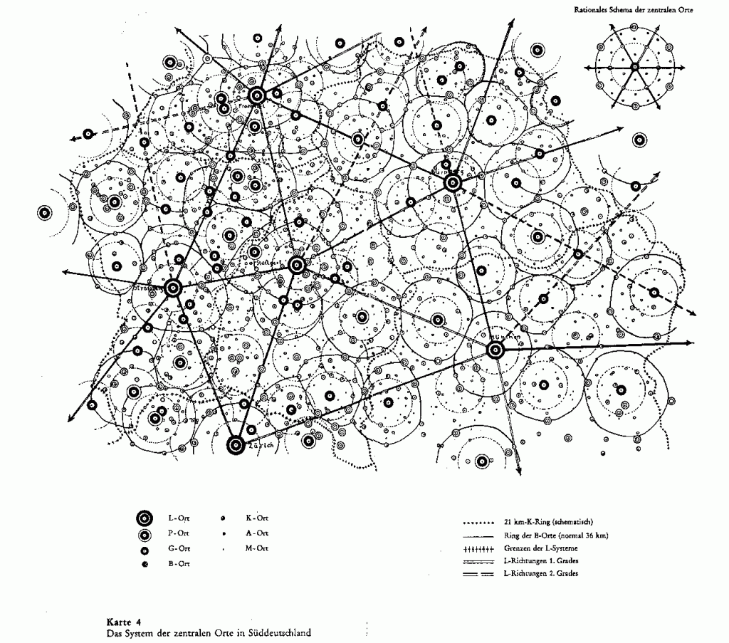
Central Place Theory
Walter Christaller 1933
Notes:
OK, but let’s discuss the various ‘laws’ of geography. One of the oldest was the concept of central place theory: it is an attempt to describe the ‘earth at night’ patterns we already saw. It has a certain platonic quality of trying to derive a spatial structure of territories for bigger and smaller cities and their relative spatial organization…

Slide 6
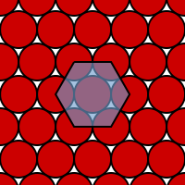
Central Place Theory
an unbounded, homogeneous, limitless plane
an evenly distributed population
all settlements are equidistant
Kepler, Lagrange, Gauss…
Notes:
It made certain assumptions about homogeneous packing of settlements on the 2D plane, which as was known for a long time leads to an hexagonal (honeycomb) pattern of organization.

Slide 7
Central Place Theory
hypotheses/principles
The larger the settlements are in size, the fewer in number they will be, i.e. there are many small villages, but few large cities.
The larger the settlements grow in size, the greater the distance between them, i.e. villages are usually found close together, while cities are spaced much further apart.
A settlement increases in size, the range and number of its functions will increase.
As a settlement increases in size, the number of higher-order services will also increase, i.e. a greater degree of specialization occurs in the services.
Zipf’s law
Urban Hierarchy
Division of Labor
Specialization, Innovation
Notes:
So of the statements of central place theory here very insightful especially about the hierarchy of functions and the deep division of labor in larger cities, as we have seen before. The spatial part was too rigid, though. It also anticipated other laws of geography such as Zipf’s law (more on that later).

Slide 8
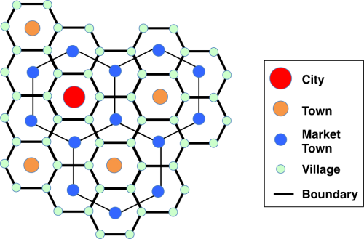
Spatial Arrangement of Urban Hierarchy
Nested Hexagonal Lattices of Larger and Larger Cities.
Notes:
Here’s what Christaler thought was going on spatially…

Slide 9
credit: NASA
Notes:
When we go back to reality some of these ideas do OK: the largest cities in the US are more or less as far away from each other as possible … and we could squint sometimes and try to see hexagonal lattices, but in general things are more complicated and interesting.

Slide 10
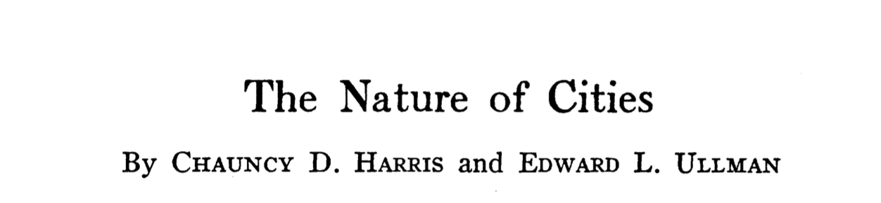

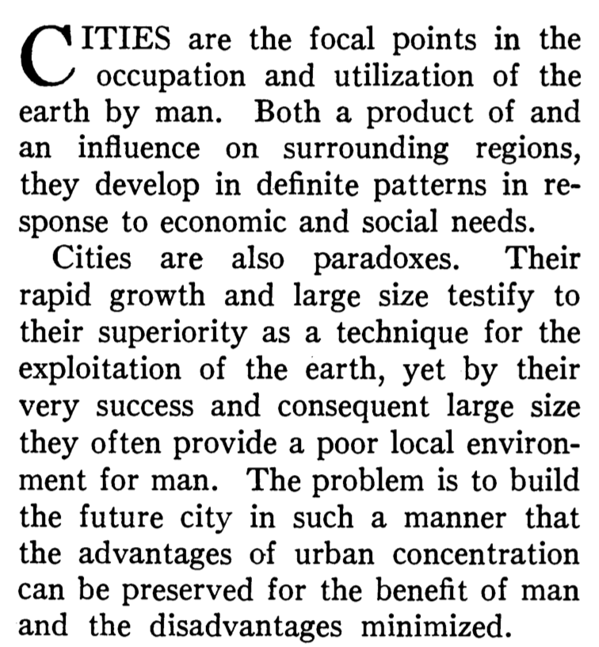
university of chicago
https://www.jstor.org/stable/1026055
Notes:
In a famous paper in Geography, researchers in the US imported these ideas from Europe but also started elaborating on them…

Slide 11
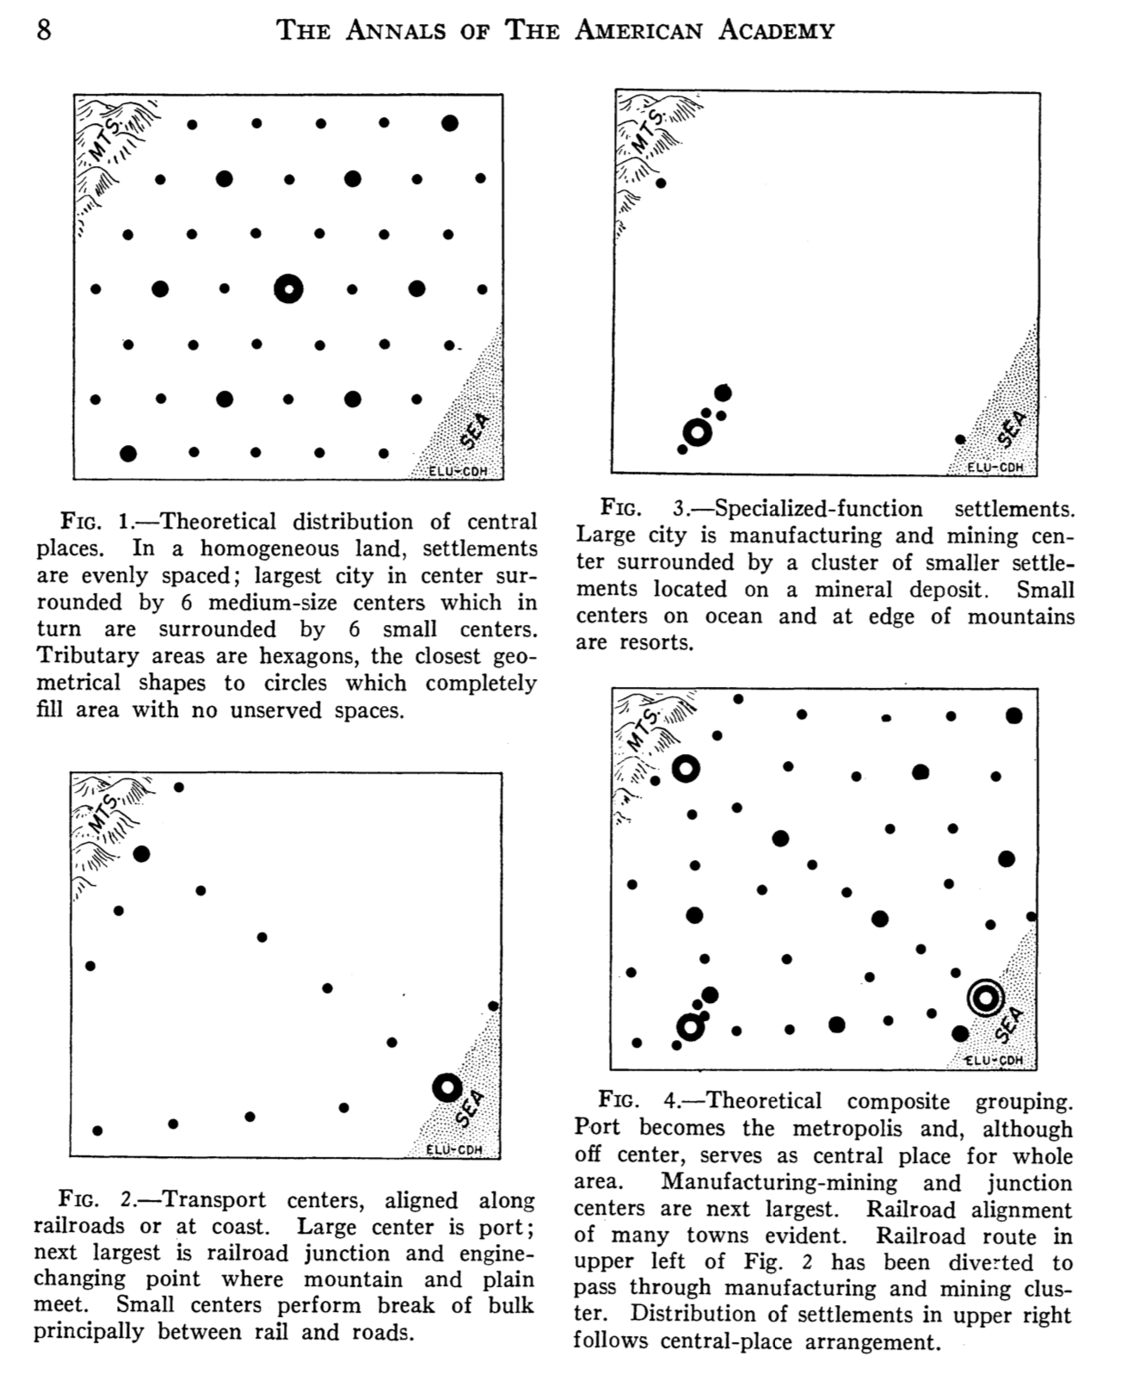
Central Places
Specialized-function Settlements
Transport Centers+Routes
Notes:
For example, due to natural resources, transport infrastructure and so on, which altogether would distort the spatial structure predicted by CPT…

Slide 12

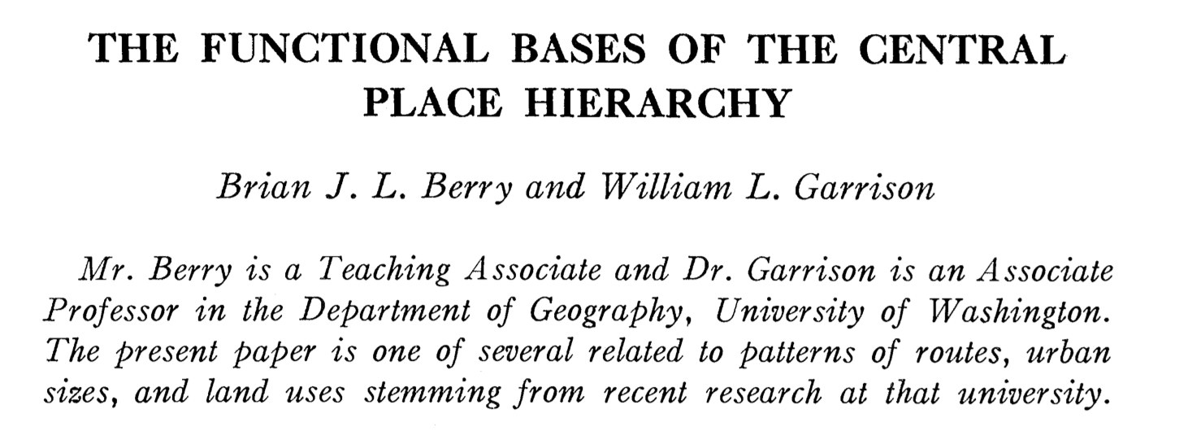
Economic Geography 1958
https://www.jstor.org/stable/142299?seq=1#metadata_info_tab_contents
Notes:
At the same time, the first results of the quantitative revolution did confirm the less spatial parts of the theorem namely the ideas of functional hierarchies based on city size.

Slide 13
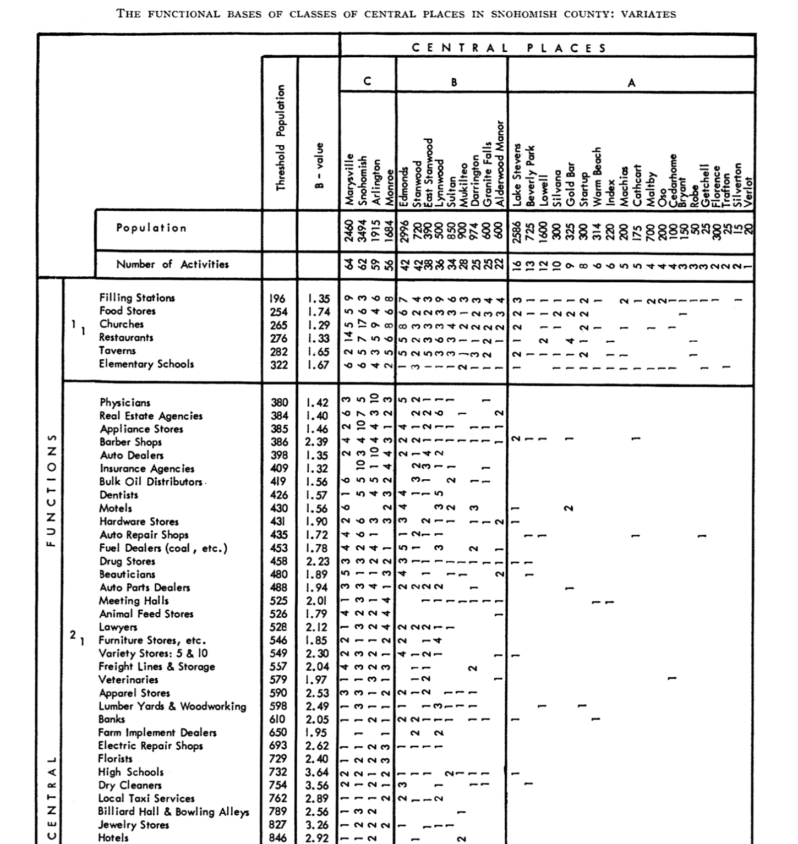
Businesses / Services
Places
https://www.jstor.org/stable/142299?seq=1#metadata_info_tab_contents
Notes:
Here’s a matrix of functions vs city size in a county outside Seattle.

Slide 14
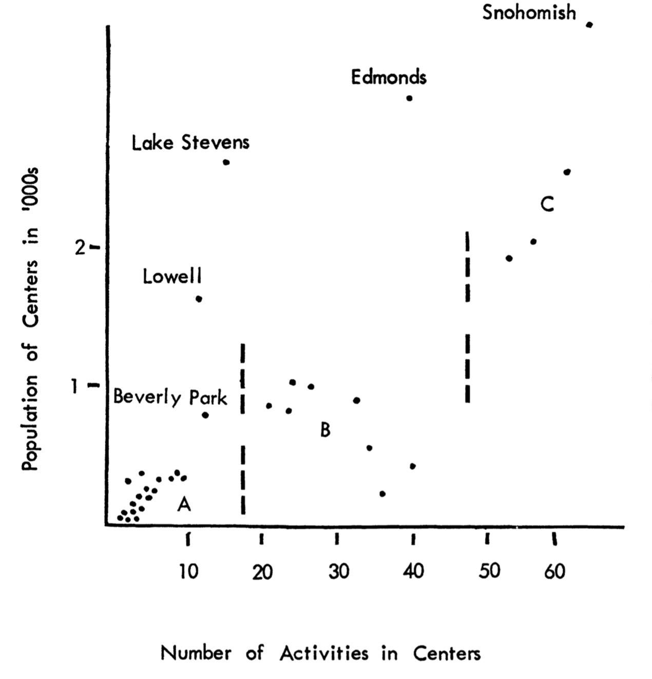
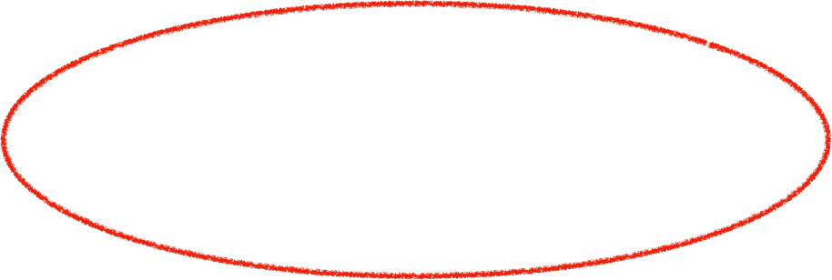
Seattle Suburbs
Business Richness= # unique types
https://www.jstor.org/stable/142299?seq=1#metadata_info_tab_contents
Notes:
This is similar to what we did when discussing professions and business types… you see here that there were these precedents to those ideas. It remained in this work to be quantified and related to other scaling patterns… even as city size here is playing an important role.

Slide 15

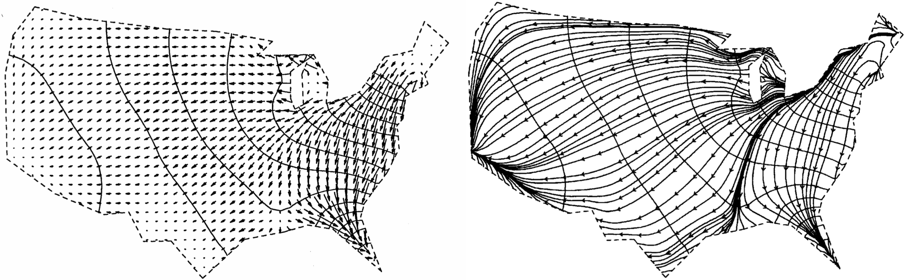
Tobler’s Laws of Geography
Waldo Tobler 1961
Tobler’s First Law:
"everything is related to everything else, but near things are more related than distant things.”
Tobler’s Second law: “The phenomenon external to an area of interest affects what goes on inside”
Notes:
Tobler was another important researcher at this time in quantitative geography, and made very beautiful and inventive maps as you can see. His two laws are purely qualitative, and hard to falsify, but often recited by heart by geographers/GIS people …

Slide 16

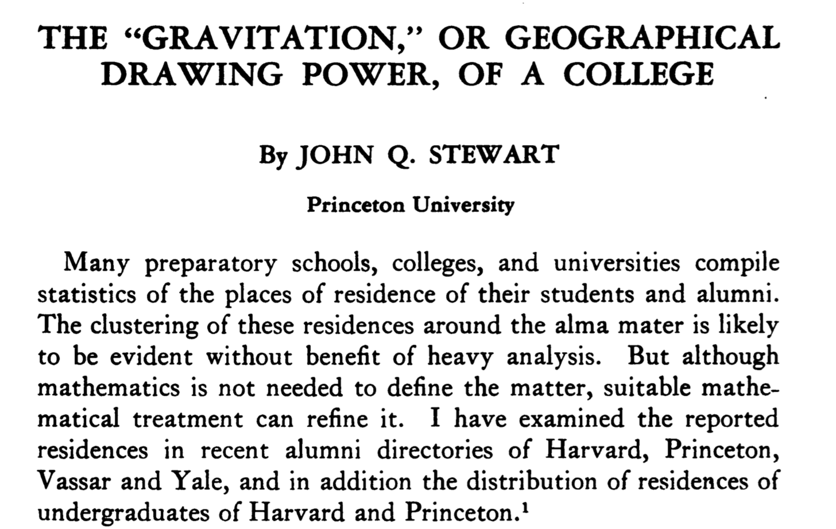

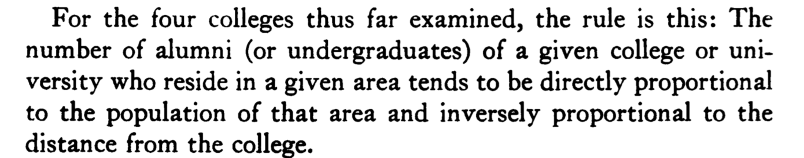
The Gravity Law of Geography
https://www.jstor.org/stable/40219181?seq=1#metadata_info_tab_contents
Notes:
Now, we are getting to the more famous and widely used ‘laws’ of geography. This next one is known as the ‘gravity law’; it has a curious and strange history in this paper above: the author was a physicist and coined the term by analogy (but with “ “) : It described that students coming to the 4 universities were more likely to come from close by inversely with distance and proportional to the population size of the place of origin

Slide 17
Flows between two Cities:
number of people per unit time
$$J_{ij}=G\frac{N_{i}N_{j}}{d_{ij}^{a}}$$
$$a≃1-2$$
Applies to migration, trade flows, commuting, ….
“gravity” law
Population “Potential” or “Influence”
$$V_{i}=G\frac{N_{i}}{d_{i}^{a}}$$
Notes:
It became conventionally written like this. Note that the units are people per some unit of time, so this is a flow of people between two places. The N’s are populations and d_ij the distance between them. G is a constant that sets the units right. Sometimes the distance is placed to a power a. By analogy to gravity this is also written as the potential of a place…

Slide 18
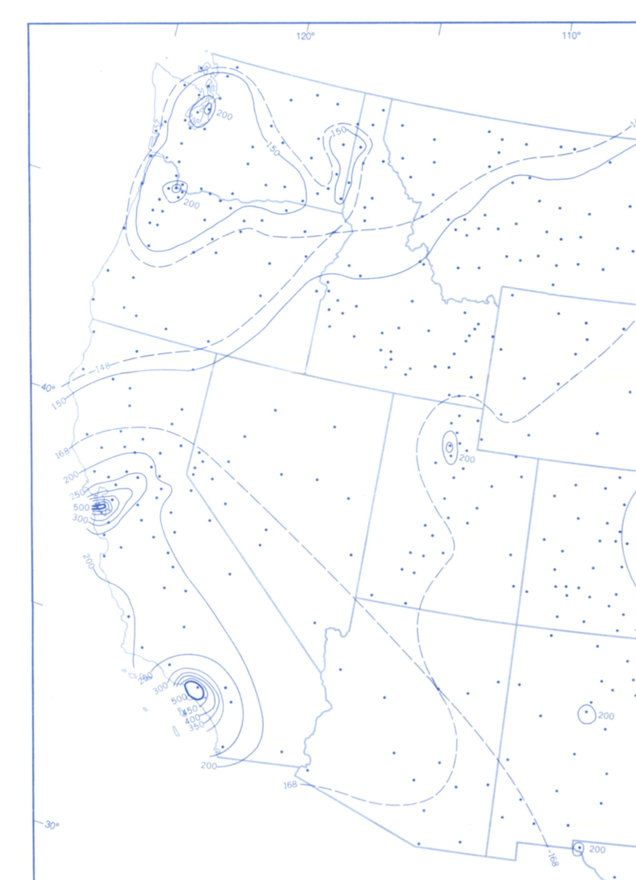
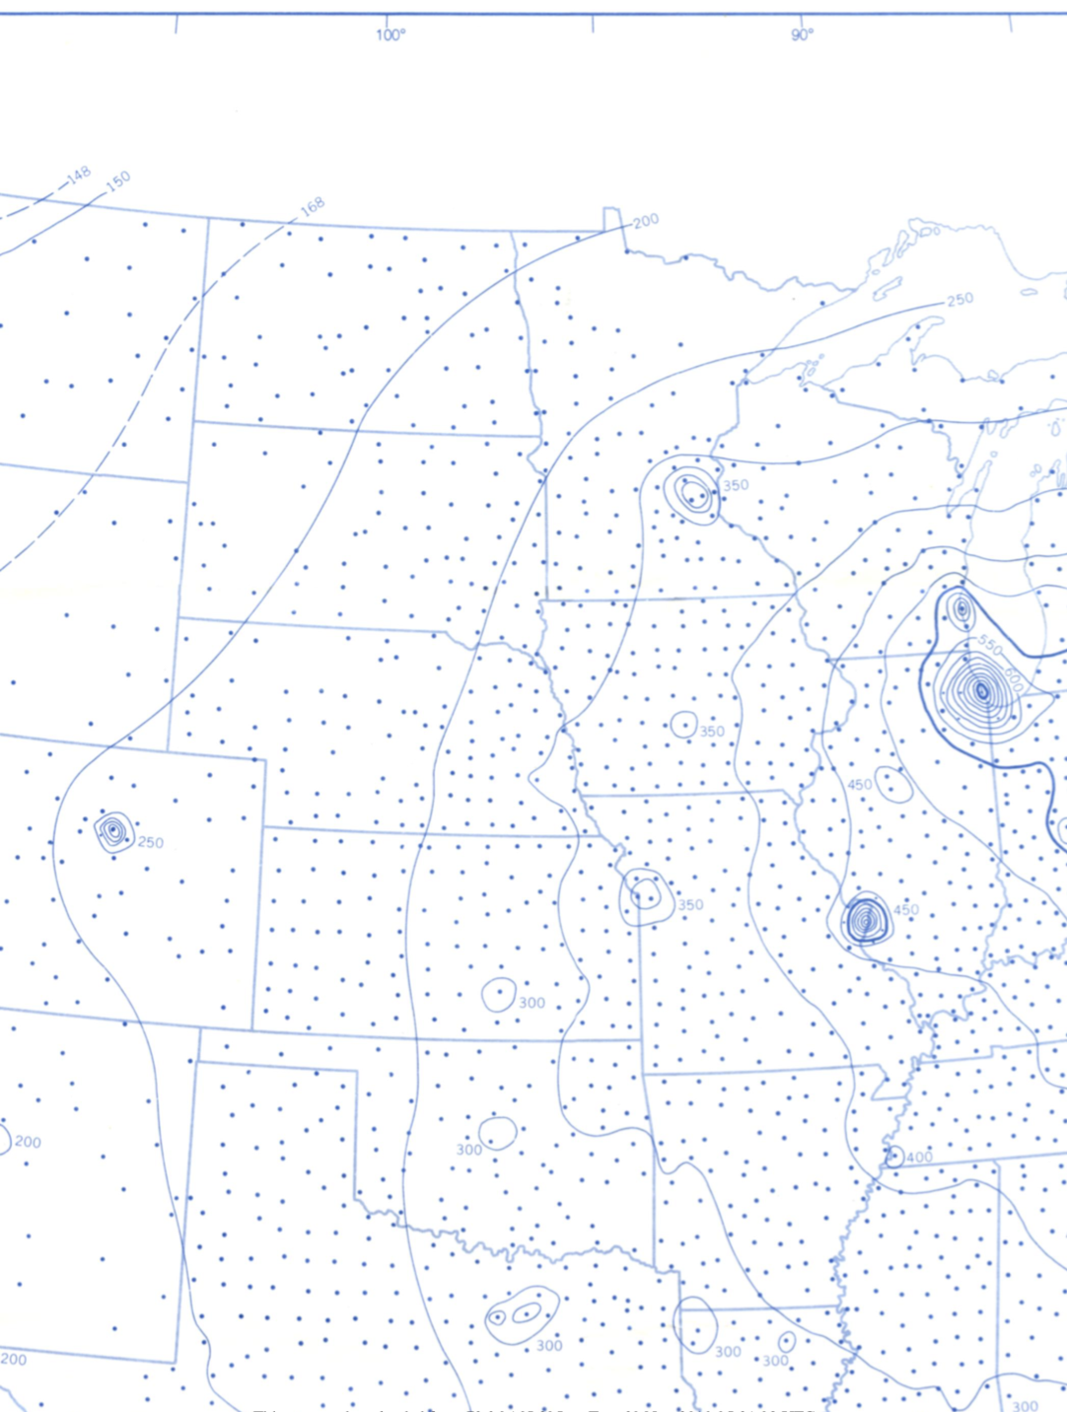
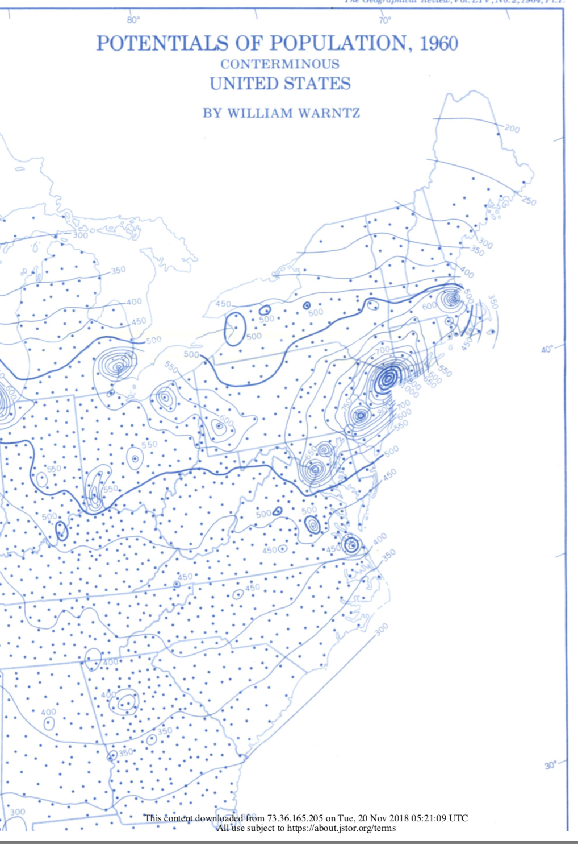
https://www.jstor.org/stable/pdf/213185.pdf?refreqid=excelsior%3A28b38a0688cb16bd5725c0148a1ea224
Notes:
Here’s an old, but at the time quite famous, paper on the potentials of each city. You see for example that NYC, Boston, Philly and Chicago are all in the same basin of attraction (with the thicker line) Warntz was at Harvard where GIS (and arcGIS) came out of these ideas.

Slide 19
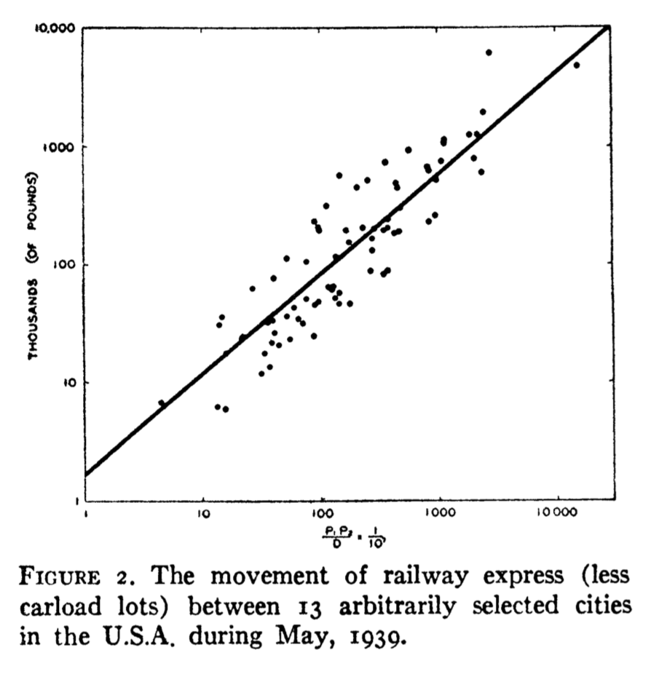
GK Zipf, 1947
Notes:
These ideas were then popularized by by Zipf, who also estimated in a number of other contexts.

Slide 20
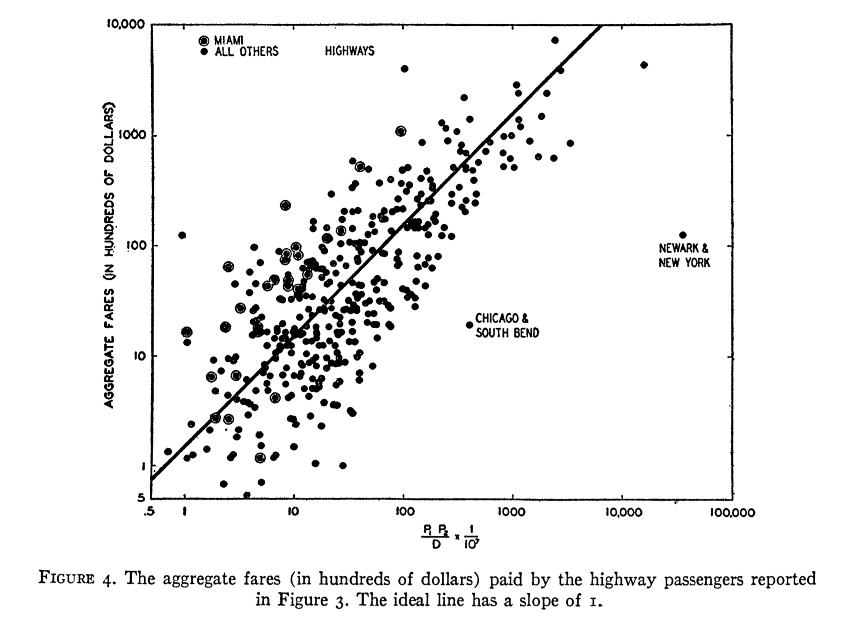
GK Zipf, 1947

Slide 21
Many attempts at explanation !!
Not Physics !!
A simple picture
Social Outputs of Interactions ~ People moving per unit time
different cities
$$I_{ij}=G\frac{N_{i}N_{j}}{A_{n}}$$
$$J_{ij}=G^{′}\frac{N_{i}N_{j}}{d_{ij}^{a}}$$
$$A_{n}→d_{ij}^{a}$$
a=1, line
a=2, area
interaction area
fractal dimension
Notes:
There have been many attempts to derive the “gravity law” from theory (see book for a review): one way to see it is to use the derivation of social rates (here leading to movement) but where the interaction area is between the two cities, when these are far away a-> 1 and when they are within the same city this becomes the relevant interaction area (the networked built up care of the city). This at least has the advantage of using the same principles at different scales.

Slide 22
Problems with Gravity Law
works roughly, but…
1) never very precise
2) The exponent $a$ varies a lot
3) Is symmetric : same number of people moving from city i-> j, as j->i !?
no growth from migration
So the gravity law cannot predict the growth of cities via migration !
Notes:
There are a number of problems with the form of the gravity law as a model to describe actual observed flows, such as for example for migration. The worst is that it is symmetric so flows in both directions are the same. This is not true in general and differences carry information for example about which city is preferred at a given time as a destination for migration…

Slide 23
Gibrat’s Law
law of proportional growth
“Les inegalites economiques; applications: aux inegalite's des richesses, a la concentration des entreprises, aux populations des villes, aux statistiques des familles, etc., d'une loi nouvelle, la loi de l'effet proportionnel.”
Paris: Librairie du Recueil Sirey, 1931.
$$r_{t}-r_{t-1}=ηr_{t}$$
$$r_{t}=(1+η_{t})r_{t-1}=(1+η_{t})(1+η_{t-1})...(1-η_{0})r_{0}∼(1+η)^{t}r_{0}$$
exponential growth
http://pi.lib.uchicago.edu/1001/cat/bib/2014808
Notes:
Another law of geography (actually this one plays a auxiliary role) is known as Gibrat’s law. It was first discussed in the context of firms, and later applied to cities. It says - in modern language - that all cities grow exponentially and that the growth rate (and in some versions its statistics, mean + variance over time) are city size independent. When this is true Zipf’s law follows under known conditions.

Slide 24
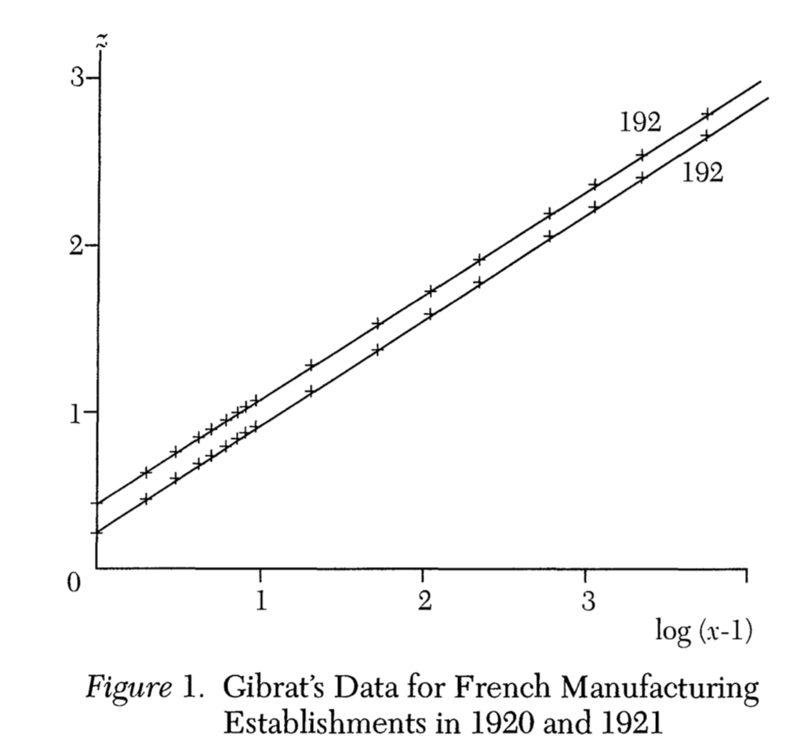
Growth is approximately independent of firm size
new size class of firm
1
0
previous size of firm
Notes:
This is not very true of firms, it is actually a better description of a set of cities within the same urban system…

Slide 25
Gibrat’s law for cities
All cities grow with the same
average population growth rate
volatility
$$\overline{η}$$
$$σ$$
independent of population size !!
Notes:
This is the stringer version, treating the growth rate as a statistical quantity.

Slide 26
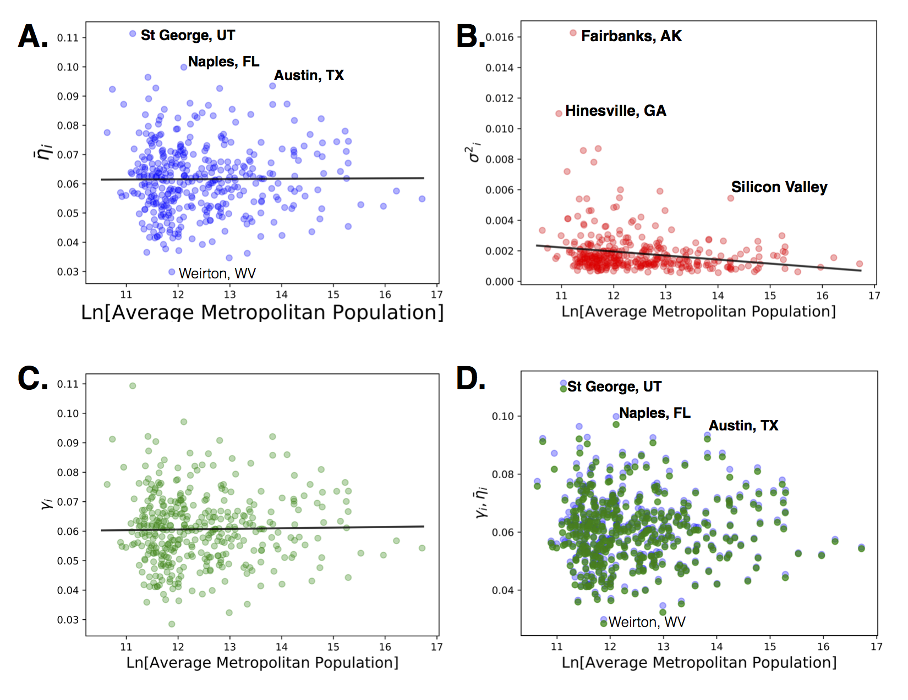
Testing Gibrat’s assumption
Population growth rare
$$γ=η-σ^{2}/2$$
Notes:
We can test it by measuring it, for example for US MSAs. We see that it is approximately true on average (though there are significant variations they are not clearly city size dependent). The variance (or volatility, in red) may appear a little size dependent however, but it his a very small number as shown in panels C, D for the effective growth rate versus the average growth rate.

Slide 27
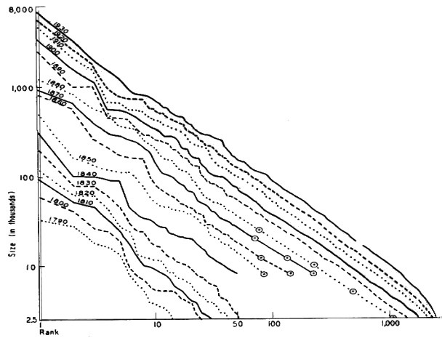
Zipf’s Law for the Size Distribution of Cities
8,000
1930
1920
1910
1900
1890
1,000
1880
1870
1860
1850
100
1840
1830
1820
Population (thousands)
1800
1810
1790
10
2.5
1
10
50
100
1,000
Rank
G K Zipf (1949), Human behavior and the principle of least effort
https://openlibrary.org/books/OL6048217M/Human_behavior_and_the_principle_of_least_effort
Notes:
Finally, the most famous of the laws of geography is known as Zipf’s law. It is a description of the distribution (probability) of city sizes. Zipf noticed that when plotted as the population versus the rank (largest city, rank=1, second rank=2, etc) in log-log one finds approximately a straight-line of slope -1. I added the grey thick lines to show you that it is not quite right, especially for small cities… more on that in a moment.

Slide 28
The Meaning of Zipf’s Law
$$N(rank)=\frac{N_{max}}{rank}$$
population size of city
$$N(rank=1)=N_{max}$$
New York City: 20.3 million
$$N(rank=2)=\frac{N_{max}}{2}$$
Los Angeles: 13.13 million
$$N(rank=3)=\frac{N_{max}}{3}$$
Chicago: 9.533 million
$$N(rank=4)=\frac{N_{max}}{4}$$
Dallas/Ft Worth: 7.233 million
Can be explained based on Gibrat’s Law ++
Notes:
Zipf’s law - written as a relation between size and rank, the ‘rank-size’ rule - has a nice, simple interpretation: the second largest city is predicted to be 1/2 the size of the largest, the 3rd 1/3 and so on. I wrote the population of the largest urban areas in the US on the right for reference… not too bad, not too good? People fight about whether they find this good enough or bad … traditionally, geographers took this as an almost exact result…

Slide 29
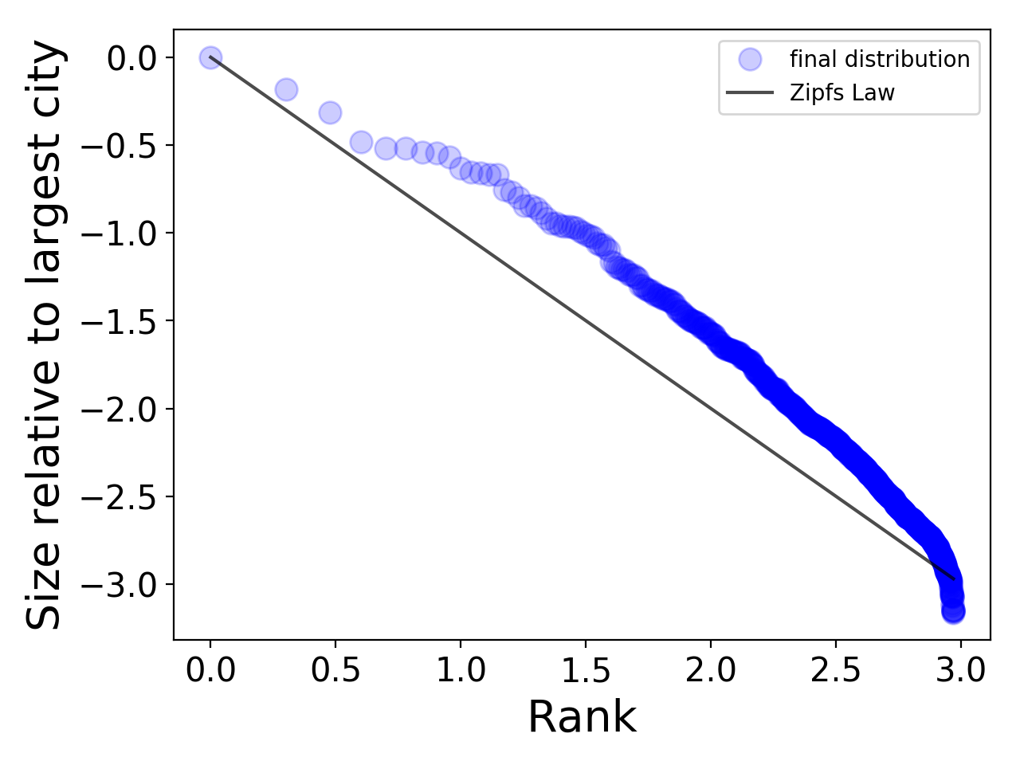


LA
NYC
Chicago
Secondary larger
cities too big.
Testing Zipf’s Law for the USA (Metros)
Zipf’s Law
Small cities too small
Notes:
For US MSAs, the entire plot looks like this. You can see that it is not very good anywhere. The larger medium cities are too large and the very small cities are too small. If you took this at face value, one conclusion could be that NYC, LA, Chicago are too small, given the medium sized cities in the US. We will see in the next module why this is…

Slide 30
The Laws of Geography
Give us an approximate, quantitative description of the dynamics of systems of cities
Where do they come from? What do deviations “mean”?
Notes:
OK - so to conclude for now. The “laws” of geography are empirical regularities, that were discovered a bit by trial and error. There is some logic to them, but we would like to better understand where they are coming from and what does it mean when they don’t work very well (or when they work perfectly). The next module will shed some light on these questions.

